Slide 1
Create Firebase Web App
For Android React Native
By Kieu Hua
Notes:
Nick DeJesus and Chris Mark are also working on using Firebase for their work. We have been struggled to configure the Firebase React Native Android in android and android/app build.gradles. Finally I solved my problem in using Firebase Authentication and Cloud Store. So Ray Deck asked me to give a presentation about the steps I took to make it works.

Slide 2
The Goals are:
1. Create Project in firebase console
2. Firebase Authentication for Users
3. Cloud Storage for Users’ contents
4. Download Google project json file
5. Create React Native Android App
6. Modify android/build.gradle and
android/app/build.gradle
7. Create App.js, Login.js, SimpliService.js
Notes:
So, here are the steps I am going to talk about in the process of create my demo app, SimpliService.

Slide 3
SimpliService Demo App
It use the Firebase Authentication for Users creation and verification
It use the Firebase Cloud Database for Users’ contents.

Slide 4
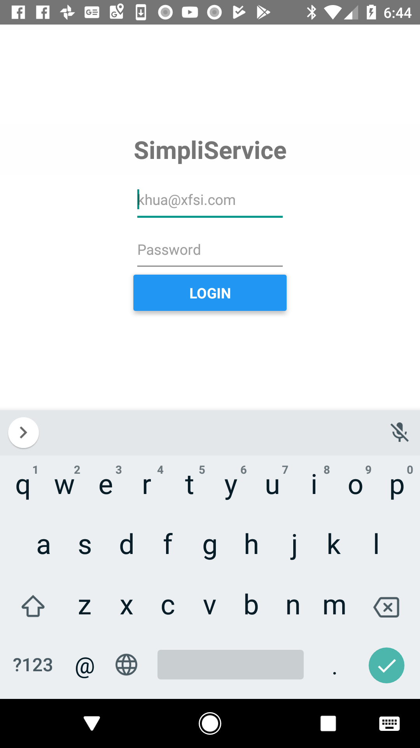
User Login Screen
Notes:
It is demo app, so it is very simple, has only two screens - Login, Users’ content
For Login, user enter user email, and password. Later you will see how it works.

Slide 5
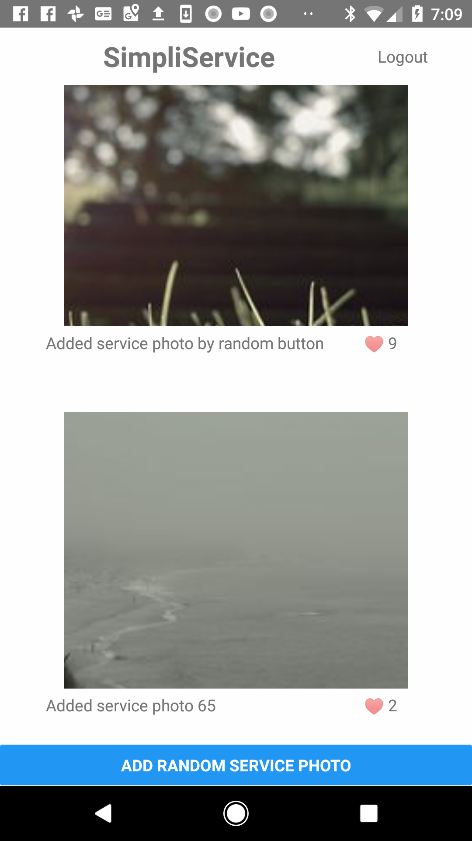
Users’ Content Screen
Notes:
User’s Content Screen will display what are the current contents in the firebase Cloud store.
And user can add more content by click Add button.

Slide 6
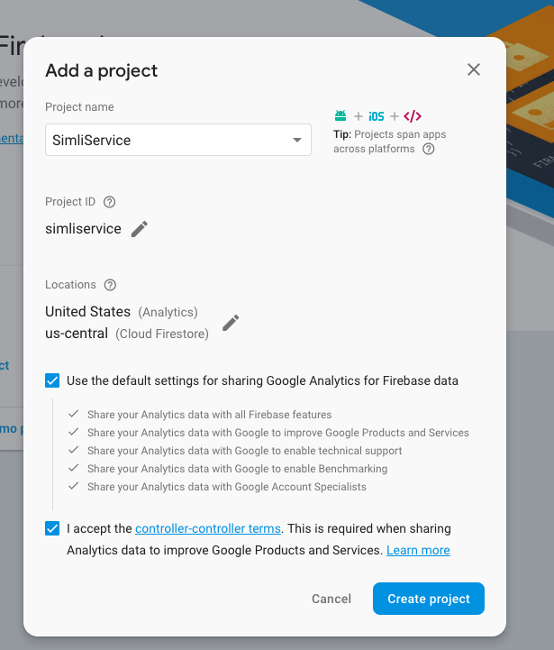
Create project on Firebase console
Notes:
You can create project on firebase before even before we create React Native Android app.
It will ask you want to create this project for Android, IOS,... I choose Android only.

Slide 7
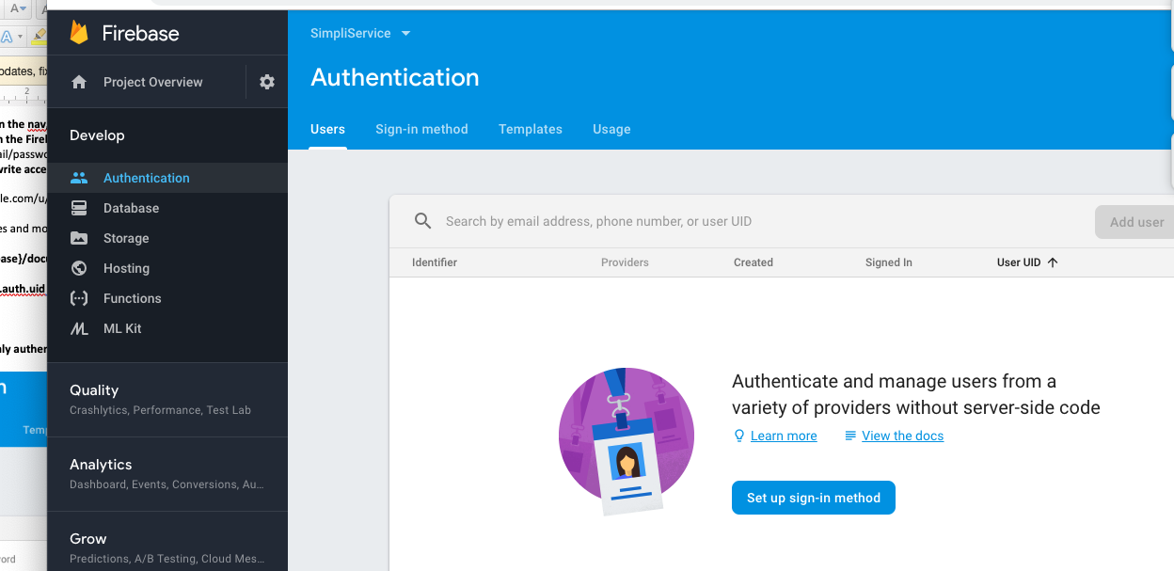
Firebase Authentication - Manage Users
Notes:
Select Authentication tab, then select “set up sign-in method”

Slide 8
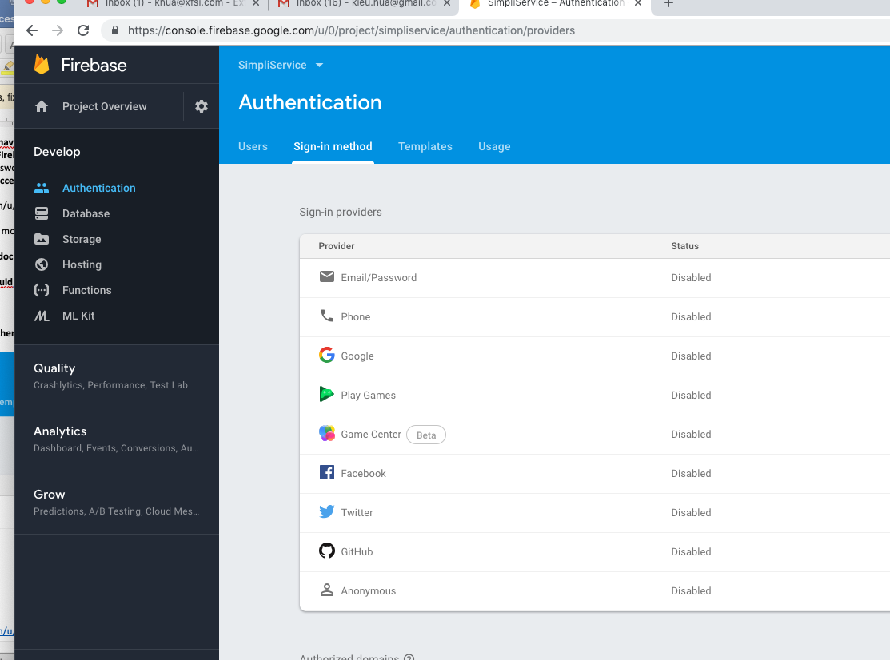
Authentication - Sign-in Methods
Notes:
So you can have many sign in method for firebase Authentication.
For this demo, I use email and password.

Slide 9
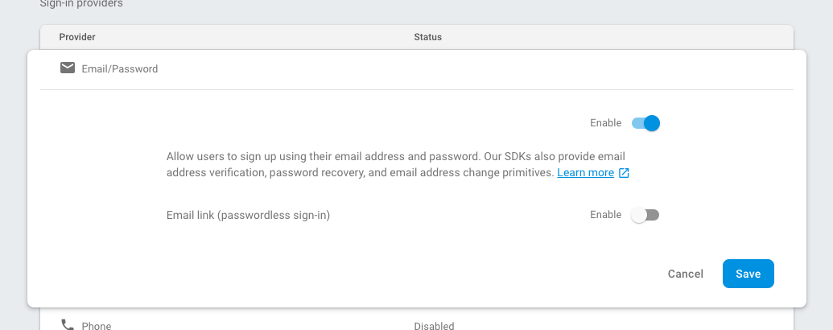
Use Email & Password Method
Notes:
There are additional options in Email/Password Sign-in methods that you can explore.

Slide 10
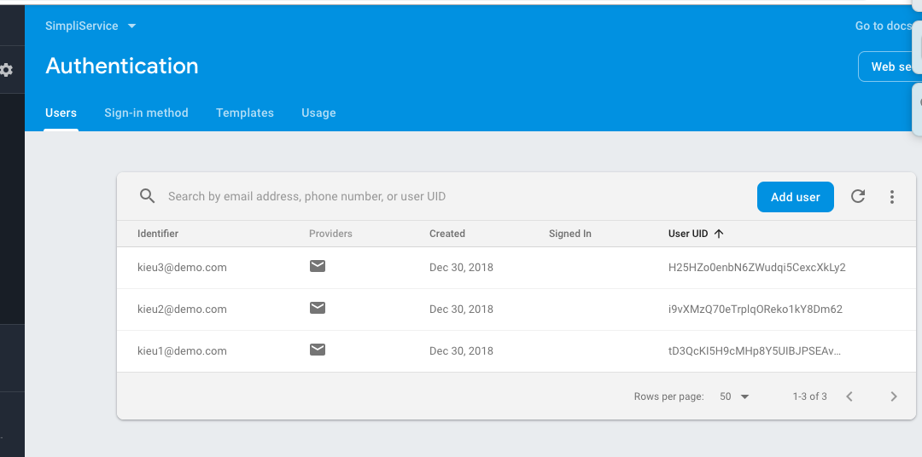
Add Users
Notes:
Here are the list of users that I add them by hand, perhaps, you can use Templates and other options to make it automatic.

Slide 11
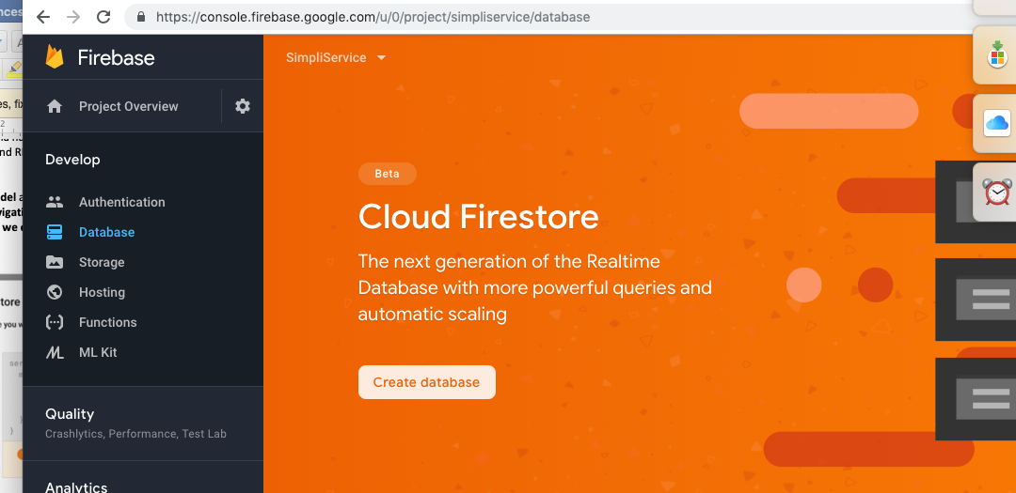
Create Users Contents Storage
Notes:
Now, we go to Cloud Firestore, you can see it is in Beta. It is better than Realtime Database. It is more powerful and cheaper.

Slide 12
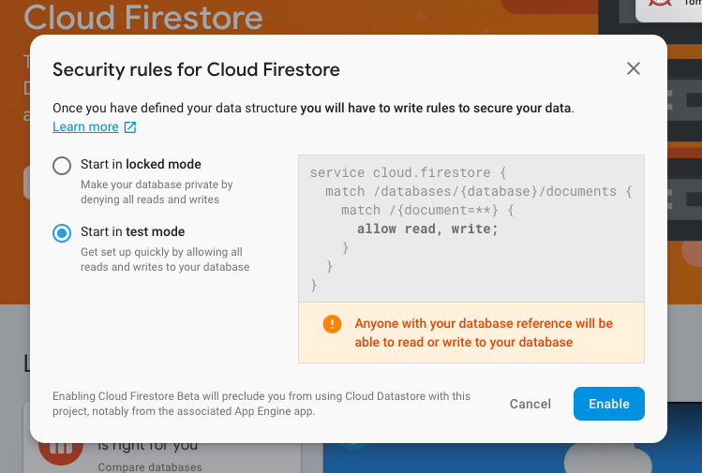
Control Access for Users’ Contents
Notes:
For demo purpose, I choose start in test mode

Slide 13
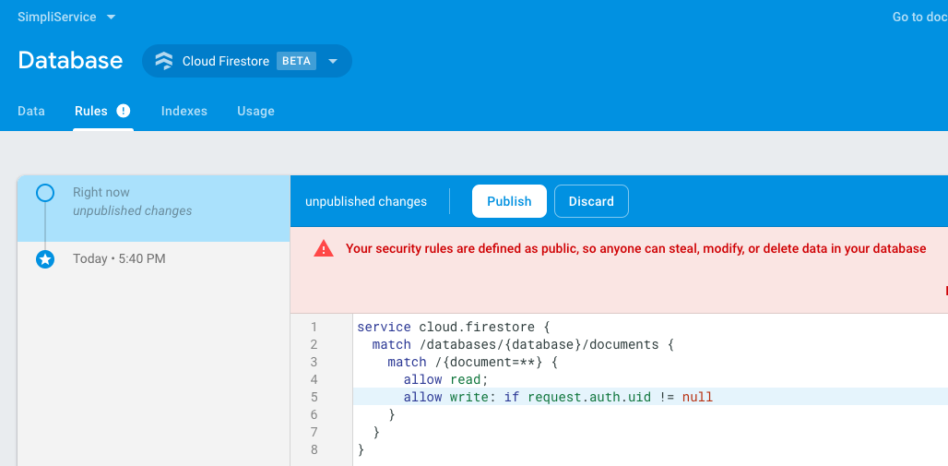
Modify Access Control for Login Users Only
Notes:
Even in the test mode, I can add additional rule to restrict access to the users container.
Allow only vendors can add and modify contents, and clients can only view the contents.

Slide 14
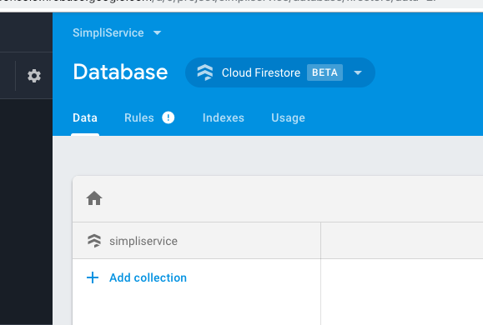
Create Users Storage
Notes:
Now, it is time to create Users contents.
Add Services collection for simpliservice app

Slide 15
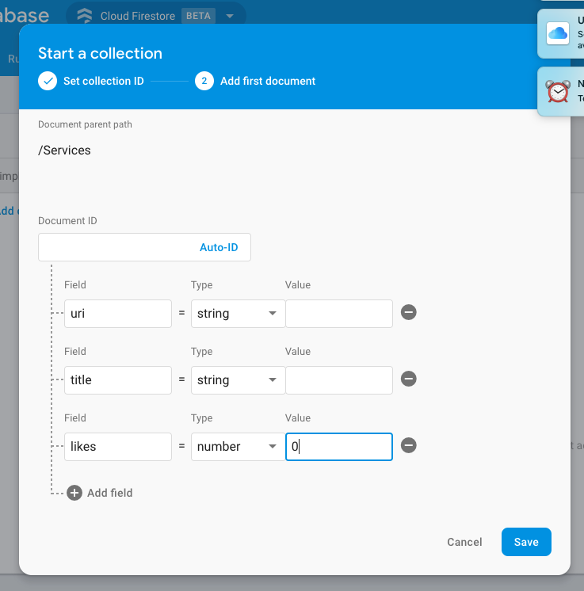
Define Schema for Users Storage
Notes:
Make sure that put initial value for type= number, otherwise “Save” button will not be high light.
type = string is default to null

Slide 16
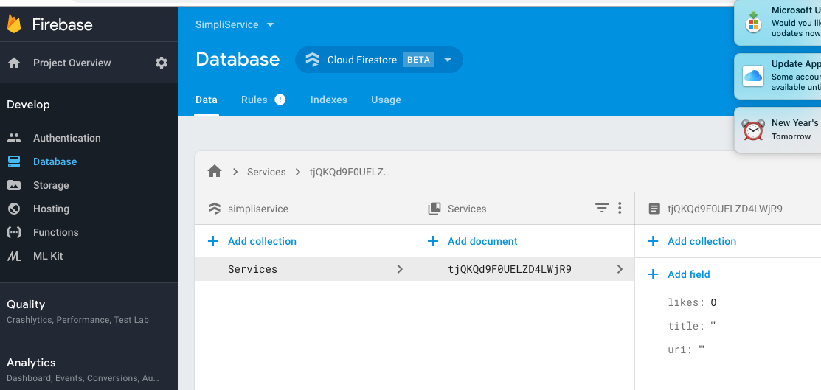
SimpliService Users Content Schema
Notes:
You can see the schema of your collection on the right. You can add additional field in the future if you need to.

Slide 17
Download google project json file
Select SimpliService project
Right Click on Project Overview
Scroll down for Download the latest config file
Select google-services.json to download the file
Notice the ‘Delete this app’ button
Notes:
We are done with firebase console. It’s time to download our configuration.
This configuration is linked between our React Native Android app to firebase.
Notice the ‘Delete this app’ button
In setting up up project, often you will find yourself need to create and delete project, because you mistype or want to change your project name. It takes about 1 day, after Google send you notification about the App deletion before actual removal of the app.

Slide 18
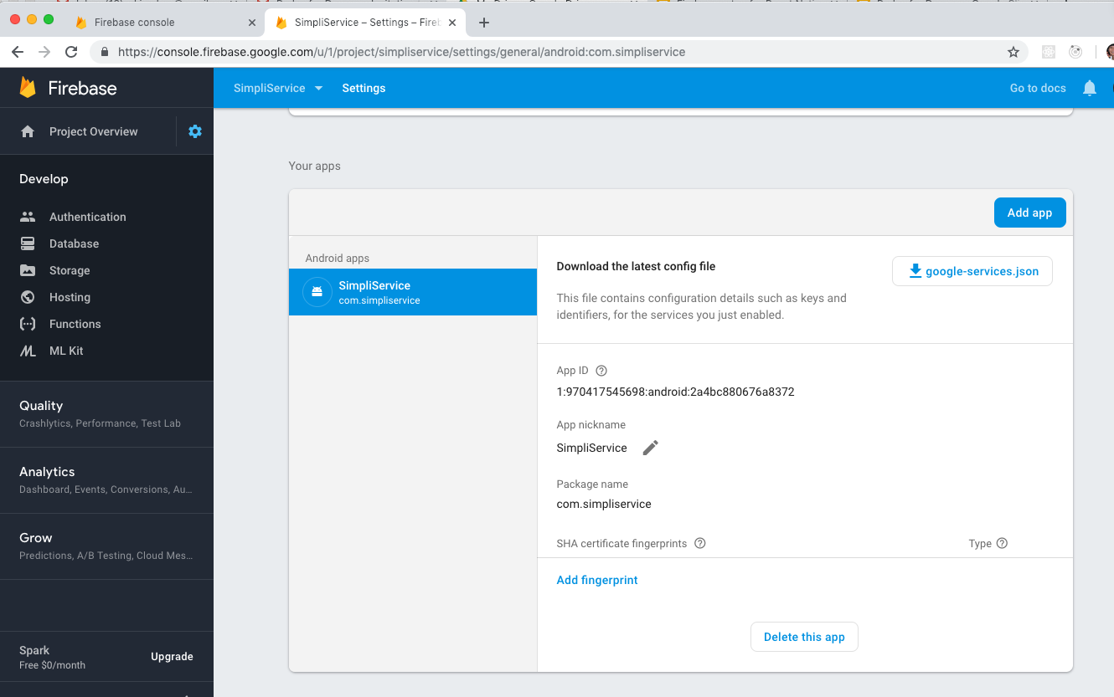
Google-services.json file
Notes:
This is the connection between Google firebase to your React Native app, you can download this file any time.

Slide 19
Create React Native Android app
Tried current React Native, and it is not working
$ react-native -v => react-native: 0.57.8
2. Use older version =”0.49.5”, and it works
$ react-native init SimpliService --version=”0.49.5”
$ npm install react-native-firebase
$ react-native link react-native-firebase
Notes:
React-native link packageName // links all native dependencies.
The purpose is to use firebase features, so older version of react-native is fine with me for now.

Slide 20
Move google-services.json to android/app/
project _info: project_number, firebase_url, project_id, storage_buket
Client:
Client_into: mobilesdk, app_id, android_client_info, package_name
Oauth_client: client_id, client_type
Api_key: current_key
Services: analytic_services, appinvite_service, ads_service
Notes:
This file has all information to connect your app to firebase.

Slide 21
Modify android/build.gradle
Buildscript { respositories { google(); jcenter() }
Dependecies { classpath ‘com.android.tools.build:gradle:3.2.1’, classpath ‘com.google.gms.google-services:4.2.0’
Allprojects { mavenLocal(); goolge(); jcenter(); maven { url “$rootDir/../node_modules/react-native/android” }}
Notes:
Now, it is the frustration part. I did a lot of google search, and try many different ways just to build Android apk without error.
If you run react-native run-android, and you have error, then you can’t go any further, so you need to fix this issue before you can use firebase with React Native.

Slide 22
Modify android/app/build.gradle
Dependencies {... implementation ‘com.google.firebase:
firebase-core: 16.0.6 Firebase-database: 16.0.5
firebase-firestore:17.1.5 Firebase-storage:16.0.5
firebase-auth:16.1.0 }
appy plugin: ‘com.google.gms.google-services’ //last line
Notes:
Because old version, “0.49.0” react-native still have old features, it gives me an old version of build.gradle, and I need to change build.‘compile’ to ‘implementation’. My SimpliService use cloud store and authentication.

Slide 23
Current firebase features on android
dependencies { implementation ‘com.google.firebase…’
core:16.0.6 // Analytics database:16.0.5 firestore:17.1.5 storage:16.0.5
crashlytics:2.9.7 auth:16.1.0 // Authentication
messaging:17.3.4 // Cloud messaging config:16.1.2 //remote config
invites:16.0.6 // Invites and Dynamic links ads:17.1.2 //AdMod

Slide 24
Current firebase features on android (cont.)
dependencies { implementation ‘com.google.firebase:...’
appindexing:17.1.0 perf:16.2.3 // Performance monitoring
functions:16.1.3 // Cloud functions for firebase Client SDK
ml-vision:18.0.2 // ML Kit (vision)
ml-model-interpreter:16.2.4 // Custom Model
Notes:
I able to build with all these implementations in the android/app/build.gradle without error

Slide 25
Modify MainApplication.java
Protected List<ReactPackage> getPackages() {return Arrays.<ReactPackage>asList(
new MainReactPackage(),
new RNFirebasePackage(),
new RNFirebaseFirestorePackage()
new RNFirebaseAuthPackage()
Notes:
To include the new firebase features, you need to add these New statements in Mainapplication.java

Slide 26
SimpliService Login.js
Const Login = {{ onPress, emailValue, passwordValue, onChange,..}) => return(..
<TextInput value={emailValue} onChangeText={e => onChange(e, ‘email’)}
placeholder=”khua@xfsi.com” .../>
<TextInput value={passwordValue} onChangeText={e => onChange(...)}
placeholder=”Password” .../>
<Button title=”Login onPress={onPress}
Notes:
Kieu note: onPress() onChange() callbacks are defined in App.js parent.

Slide 27
SimpliService Service.js
Const Service = ({service}) => {
<Image source={{ uri:service.uri }} … />
<Text> { service.title } </Text>
<Text>&hearts; {service.likes}</Text>
Notes:
Kieu note: &hearts; = #&#x2665 => heart symbol

Slide 28
SimpliService App.js
import {firebase} from ‘react-native-firebase’;
export default class App extends Component {
constructor() { this.ref = firebase.firestore().collection(‘services’);
This.state = { services:[], user: null, emailValue: ’’, passwordValue: ‘’, ...}
componentDidMount() {
this.auth = firebase.auth().onAuthStateChange((uesr)=> setState({user})
This.firestore = this.ref.onSnapshot(this.onCollectionUpdate)} ...
Notes:
componentWillUnmount() { unsubscribe auth and firestore }

Slide 29
SimpliSerive App.js:
onCollectionUpdate, addRandomService
onCollectionUpdate = (querySnapshot) => { querySnapshot.forEach(doc) = {
Const { uri, likes, title } = doc.data();
services.push({key:doc.id, doc, title, uri, likes}) ...
addRandomSerivce = () => {
this.ref.add( title:.., likes: …, uri: ‘https://picsum.photos/..’) ...

Slide 30
SimpliService App.js:
onLogin, onChangeLogin
onLogin = async () => const response await
firebase.auth.signInWithEmailAndPassword(..emailValue,..password.)
onChangeLogin = (e type) => { this.setState({ [`${type}Value`]: e })}

Slide 31
SimpliService App.js
render(): Logout button
<Text>SimpliService</Text>
{ this.state.user &&
(<TouchableOpacity onPress={() => firebase.auth().signOut() }>
<Text>Logout</Text></TouchableOpacity>

Slide 32
SimpliService App.js
render(): List services, Login
..{ this.state.user ?
(<FlatList data={...services} renderItem={{item}=><Service service={item} />}
ListFooterComponent={<Button .. onPress={addRandomService()} />
:( <Login emailValue={..} passwordValue={..}
onChange={(e,type)=> onChangeLogin(e,type), onPress{()=> .., onLogin }

Slide 33
User Login Screen

Slide 34
Users’ Content Screen

